Slide 1
Valuation of Bonds
Dr. Sarveshwar Kumar Inani
sarveshwarinani@wilp.bits-pilani.ac.in

Slide 2
Agenda:
Overview of Bond Valuation
Explain the fundamental characteristics of bonds (or debentures).
Show the use of the present value concepts in the valuation of bonds.
Duration
Convexity
International Bond Diversification
Source: The content in this ppt is borrowed from the book “Financial Markets and Institutions” by Jeff Madura (Cengage) and the Book “Financial Management” by I. M. Pandey (Vikas).

Slide 3
Features of a Bond (Or debenture)
Long-term debt instrument or security.
Interest Rate or coupon rate is fixed
Face Value or par value of Rs 100 or Rs 1,000, and interest is paid on face value.
Maturity is fixed.
Redemption value - may be redeemed at par or premium.
Market Value- may be different from par value or redemption value as it is traded in the market.

Slide 4
Types of Bonds
Bonds with maturity with periodic coupon payments
Pure discount bonds or Zero Coupon bonds. The bond discount is the difference between the par value and the selling price.
Perpetual bonds with no maturity

Slide 5
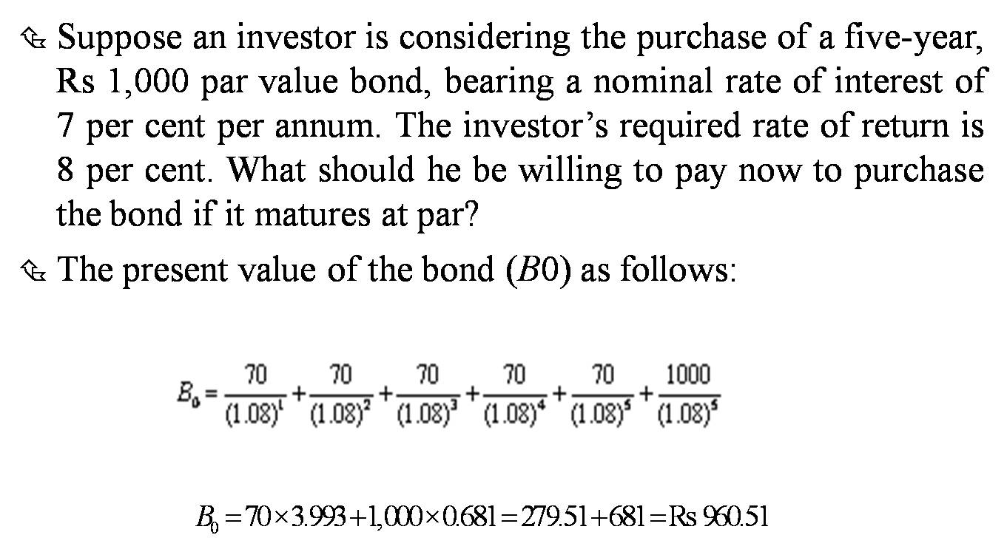
Valuation of Bond with Maturity
Bond Value = PV of all coupon payments + PV of Maturity value
Example (Do the calculation):
(Source: Numerical examples taken from the Book I.M. Pandey)

Slide 6
Practice
Consider a bond that has a par value of $1,000, pays $100 at the end of each year in coupon payments, and has three years remaining until maturity. Assume that the prevailing annualized yield on other bonds with similar characteristics is 12 percent. In this case, the appropriate price of the bond would be: (Solution: $951.97)

Slide 7
Practice
You intend to purchase a 15-year, $1,000-par-value bond that has a coupon rate of 9%.If your required return is 10%, what is the value of this bond? If the current market price for this bond is $985, should you purchase this bond? (PV of Coupons 684.54+PV of Maturity value 239.39= Total 923.93, Overvalued in market, Not buy)

Slide 8
Impact of the Discount Rate on Bond Valuation
The discount rate selected to compute the present value is critical to accurate valuation of the bond.
The appropriate discount rate for valuing any asset is the yield that could be earned on alternative investments with similar risk and maturity.
Higher interest rates lead to higher discount rates, which causes bond prices to fall.
Lower interest rates lead to lower discount rates, which causes bond prices to increase.
Bond prices and interest rates (yields) have an inverse relationship, meaning when one goes up, the other goes down

Slide 9
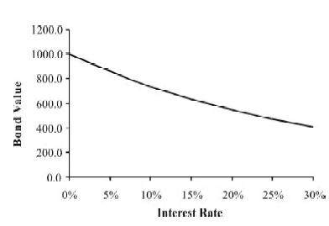
Bond Values and Changes in Interest Rates
The value of the bond declines as the market interest rate (discount rate) increases.
The value of a 10-year, 12 per cent Rs 1,000 bond for the market interest rates ranging from 0 per cent to 30 per cent is shown in the figure.

Slide 10
Yield to Maturity (YTM)
YTM is the measure of bond’s rate of return which considers both the annual interest income and any capital gain or loss.
YTM is bond’s internal rate of return.
YTM can be computed using EXCEL function IRR or financial calculator.
Or it can be computed using trial and error method (manually).
Explain with the help of previous slide example.

Slide 11
Impact of the Timing of Payments on Bond Valuation
The market price of a bond is also affected by the timing of the payments made to bondholders.
Funds received sooner can be reinvested to earn additional returns.
In consequence, a dollar to be received soon has a higher present value than one to be received later.

Slide 12
Current Yield
Current yield is the annual interest divided by the bond’s current value.
Example: The annual interest is Rs 60 on the current investment of Rs 883.40. Therefore, the current rate of return or the current yield is: 60/883.40 = 6.8 per cent.
Current yield does not account for the capital gain or loss.

Slide 13
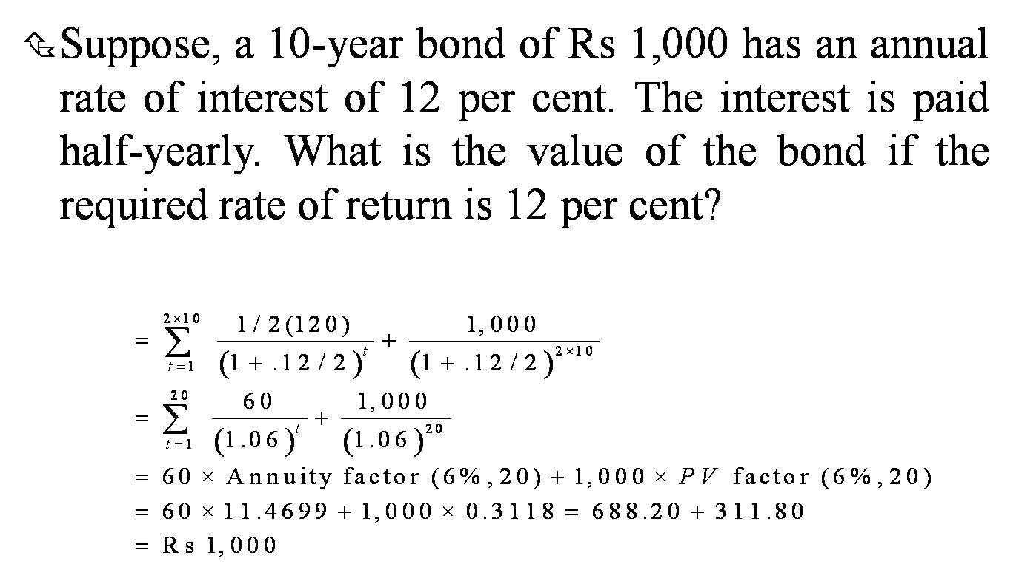
Bond Values and Semi-annual Interest Payments

Slide 14
Practice
As an example of the valuation of a bond with semiannual payments, consider a bond with $1,000 par value, a 10 percent coupon rate paid semiannually, and three years to maturity. Assuming a 12 percent required return, the present value is computed as follows:
Solution: $950.82

Slide 15
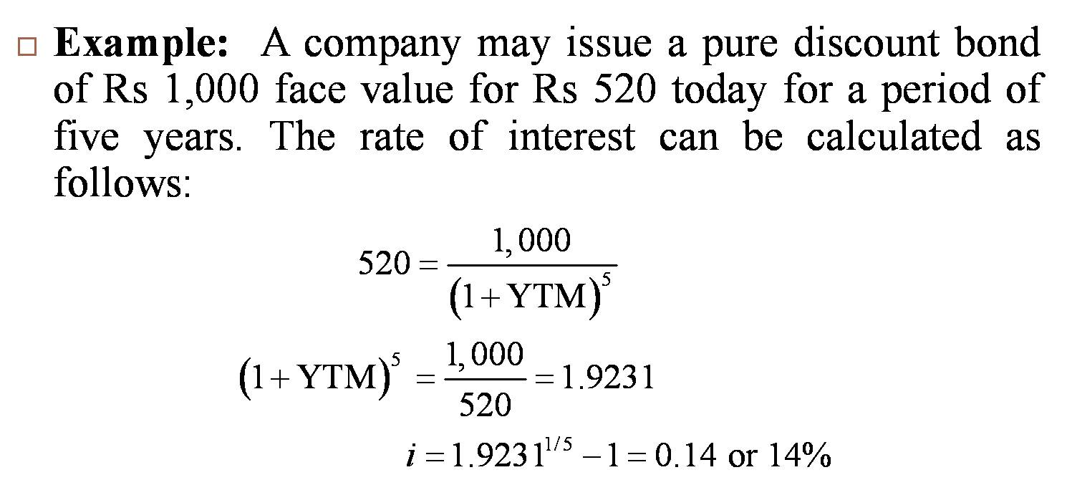
Pure Discount Bonds (Zero Coupon Bonds)
Pure discount bond do not carry an explicit rate of interest.
It provides for the payment of a lump sum amount at a future date in exchange for the current price of the bond.
The difference between the face value of the bond and its purchase price gives the return or YTM to the investor.

Slide 16
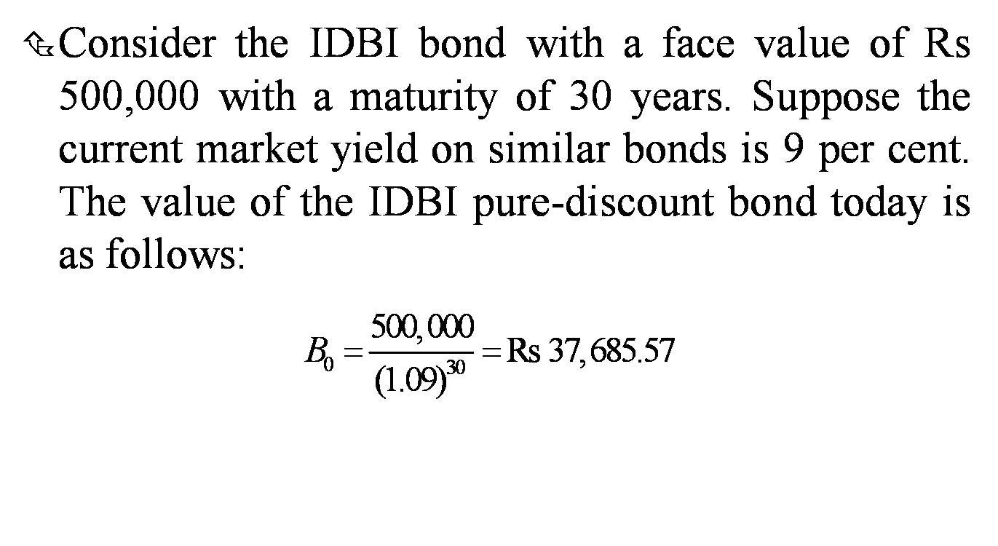
Example

Slide 17
Practice of ZCB
Consider a zero-coupon bond (which has no coupon payments) with three years remaining to maturity and a $1,000 par value. Assume the investor’s required rate of return on the bond is 13 percent. The appropriate price of this bond? (Solution: $693.05)
A zero-coupon bond with a face value of $1,000 matures in 5 years. If the market interest rate is 6%, what is the current price of the bond? ($747.26)
A zero-coupon bond with a face value of $5,000 matures in 10 years. If the current price of the bond is $3,000, what is the implied yield to maturity (YTM)? (5.24%)
A zero-coupon bond with a face value of $10,000 matures in 8 years. If the current market interest rate is 5%, what is the price of the bond? ($6768.39)

Slide 18
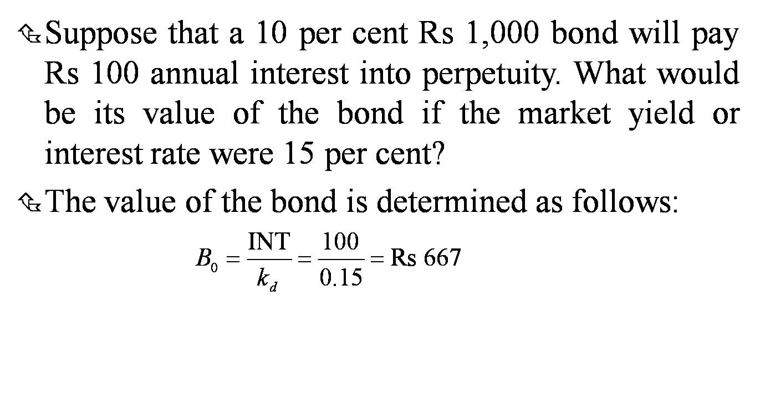
Perpetual Bonds
No maturity (infinite life). An example of perpetuity. Rarely found in practice.

Slide 19
Practice
A Rs 100 perpetual bond is currently selling at INR 95. The coupon rate is 13.5%, and required rate of return is 15%. Compute the value of bond. should you purchase this bond? What is YTM? (Value = INR 90, Overvalued in market, Not buy, YTM=14.21%)

Slide 20
Practice: Perpetual bonds
A perpetual bond pays a coupon of $50 per year. If the required rate of return on the bond is 8%, what is its price? ($625)
A perpetual bond pays a coupon of $75 per year. If the market interest rate increases from 6% to 7%, what is the change in the bond's price? (Minus 178.57)
A perpetual bond pays a coupon of $100 per year. If the required rate of return on the bond is 10%, what is the bond's yield to maturity (YTM)? (10% same as RRR)

Slide 21
Default Risk and Credit Rating
Default risk is the risk that a company will default on its promised obligations to bondholders.
Default premium is the spread between the promised return on a corporate bond and the return on a government bond with same maturity.
Rating agencies (CRISIL, ICRA, CARE)

Slide 22
Explaining Bond Price Movements
The required rate of return on a bond is primarily determined by the prevailing risk-free rate, which is the yield on a Treasury bond with the same maturity, and the credit risk premium on the bond.
Higher interest rates lead to lower bond prices. This risk is termed as interest rate risk.
Higher credit risk premium leads to lower bond prices.

Slide 23
Factors That Affect the Risk-Free Rate
Impact of Inflationary Expectations: More inflation more interest rates and vice-versa (Focus on crude oil prices to forecast inflationary expectations).
Impact of Economic Growth: Strong economic growth tends to generate upward pressure on interest rates (more demand of funds), whereas weak economic conditions put downward pressure on rates. Poor economy, less interest rates, higher bond prices (Buy bonds when expectation of recession). Some of the more closely monitored indicators of economic growth include employment, gross domestic product, retail sales, industrial production, and consumer confidence.

Slide 24
Factors That Affect the Risk-Free Rate
Impact of Money Supply Growth: More money supply, downward pressure on interest rates, rise in bond prices. Or more money supply, more inflation, more interest rates, bonds prices decline. Any situation possible!
Impact of Budget Deficit: Increased borrowing by the Treasury can result in a higher required return on Treasury bonds. That is, the long-term risk-free rate rises, which results in lower prices on existing bonds with long terms remaining until maturity.

Slide 25
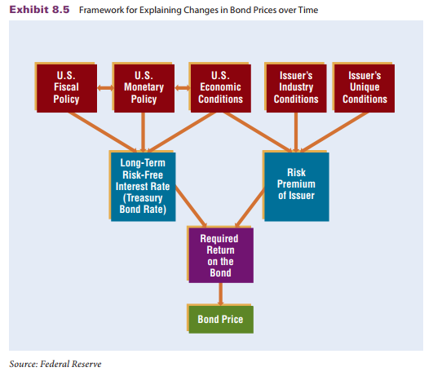
Summary of Factors Affecting Bond Prices

Slide 26
Sensitivity of Bond Prices to Interest Rate
Movements
Investors can measure the sensitivity of their bonds’ prices to interest rate movements, which will indicate the potential damage to their bond holdings in response to an increase in interest rates (and therefore in the required rate of return on bonds).
Two common methods for assessing the sensitivity of bonds to a change in the required rate of return on bonds are (1) bond price elasticity and (2) duration.

Slide 27
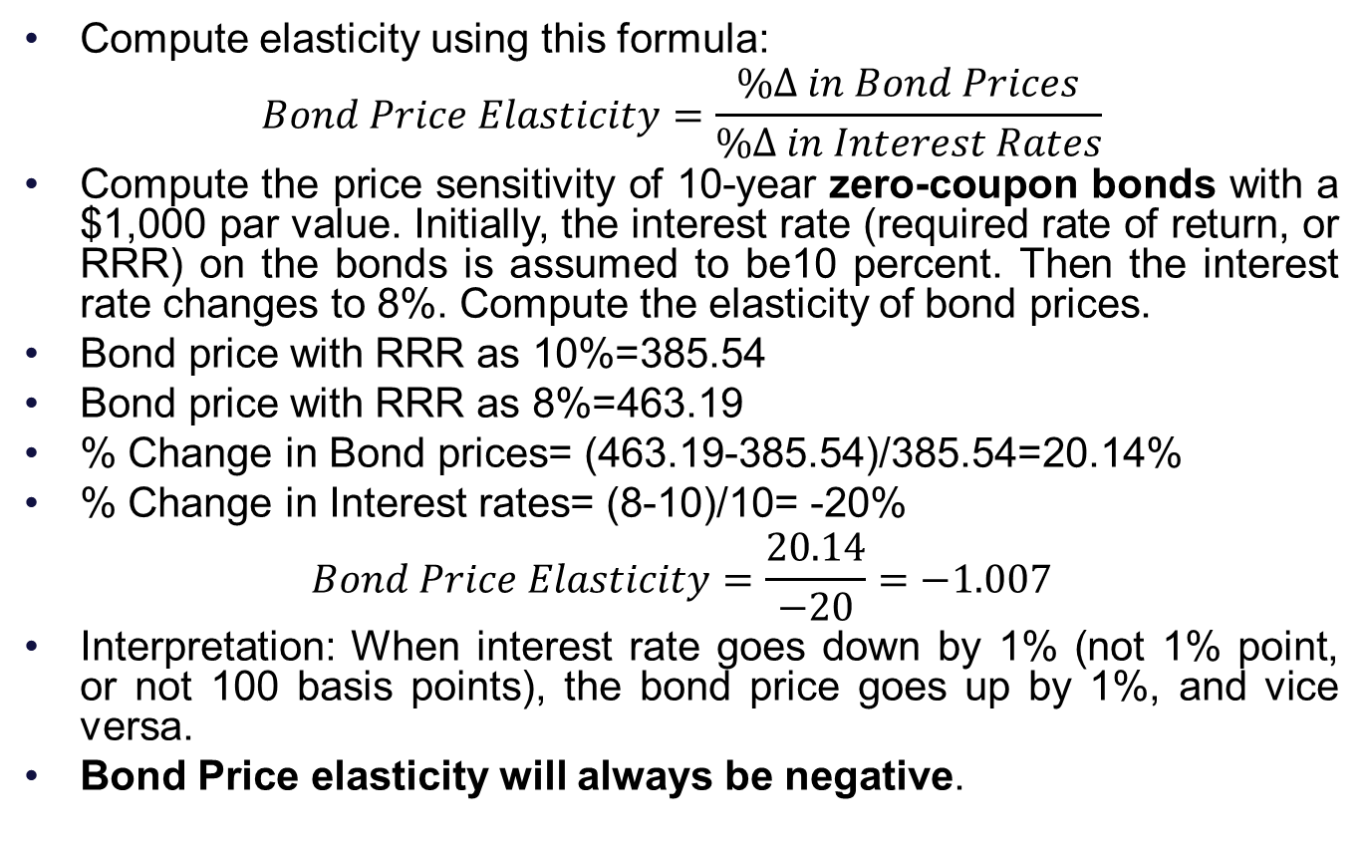
1. Bond Price Elasticity
Compute elasticity using this formula:
$$Bond Price Elasticity=\frac{\%∆ in Bond Prices}{\%∆ in Interest Rates}$$
Compute the price sensitivity of 10-year zero-coupon bonds with a $1,000 par value. Initially, the interest rate (required rate of return, or RRR) on the bonds is assumed to be10 percent. Then the interest rate changes to 8%. Compute the elasticity of bond prices.
Bond price with RRR as 10%=385.54
Bond price with RRR as 8%=463.19
% Change in Bond prices= (463.19-385.54)/385.54=20.14%
% Change in Interest rates= (8-10)/10= -20%
$$Bond Price Elasticity=\frac{20.14}{−20}=−1.007$$
Interpretation: When interest rate goes down by 1% (not 1% point, or not 100 basis points), the bond price goes up by 1%, and vice versa.
Bond Price elasticity will always be negative.

Slide 28
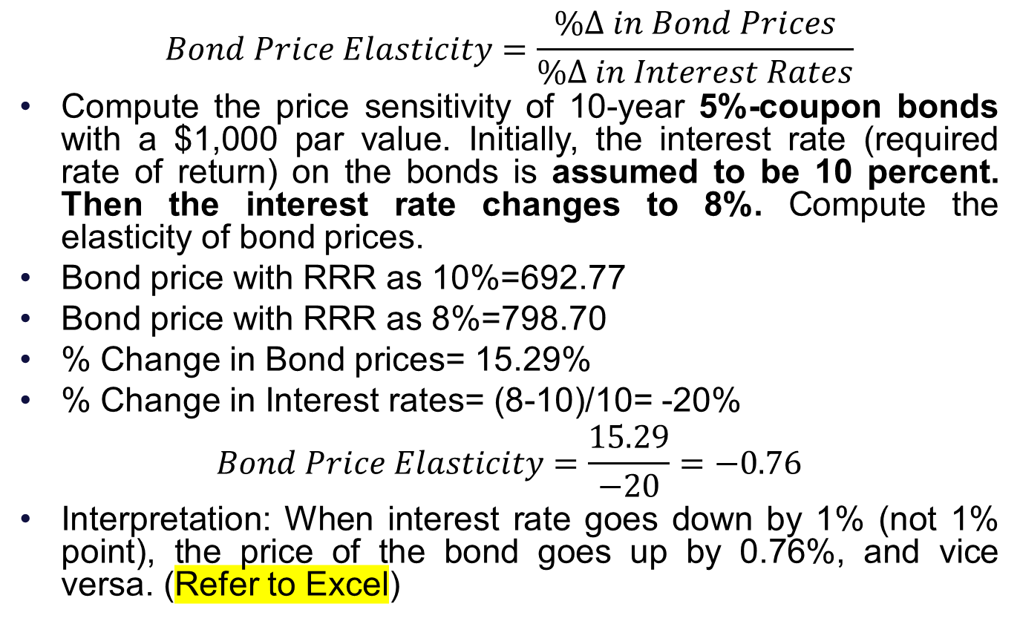
Practice: Bond Price Elasticity
$$Bond Price Elasticity=\frac{\%∆ in Bond Prices}{\%∆ in Interest Rates}$$
Compute the price sensitivity of 10-year 5%-coupon bonds with a $1,000 par value. Initially, the interest rate (required rate of return) on the bonds is assumed to be 10 percent. Then the interest rate changes to 8%. Compute the elasticity of bond prices.
Bond price with RRR as 10%=692.77
Bond price with RRR as 8%=798.70
% Change in Bond prices= 15.29%
% Change in Interest rates= (8-10)/10= -20%
$$Bond Price Elasticity=\frac{15.29}{−20}=−0.76$$
Interpretation: When interest rate goes down by 1% (not 1% point), the price of the bond goes up by 0.76%, and vice versa. (Refer to Excel)

Slide 29
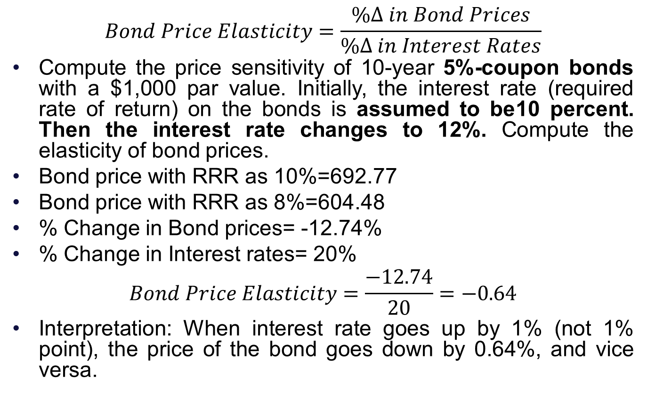
Practice: Bond Price Elasticity
$$Bond Price Elasticity=\frac{\%∆ in Bond Prices}{\%∆ in Interest Rates}$$
Compute the price sensitivity of 10-year 5%-coupon bonds with a $1,000 par value. Initially, the interest rate (required rate of return) on the bonds is assumed to be10 percent. Then the interest rate changes to 12%. Compute the elasticity of bond prices.
Bond price with RRR as 10%=692.77
Bond price with RRR as 8%=604.48
% Change in Bond prices= -12.74%
% Change in Interest rates= 20%
$$Bond Price Elasticity=\frac{−12.74}{20}=−0.64$$
Interpretation: When interest rate goes up by 1% (not 1% point), the price of the bond goes down by 0.64%, and vice versa.

Slide 30
Influence of Coupon Rate on Bond Price Sensitivity
A zero-coupon bond, which pays all of its proceeds to the investor at maturity, is most sensitive to changes in the required rate of return because the adjusted discount rate is applied to one lump sum in the distant future.
The price of a bond that pays all its yield in the form of coupon payments is less sensitive to changes in the required rate of return because the adjusted discount rate is applied to some payments that occur in the near future as well as some payments made in the distant future.
Less Risk in High-coupon bonds. The price elasticities of the higher-coupon bonds are considerably lower than the price elasticity of the zero-coupon bond.
Restructuring of bond portfolios:
Expect a decline in interest rates: Buy low- or zero-coupon bonds.
Expect a rise in interest rates: Buy high-coupon bonds.

Slide 31
Influence of Maturity on Bond Price Sensitivity
As interest rates (or required rates of return) decrease, long-term bond prices (as measured by their present value) increase by a greater degree than short-term bond prices.
The long-term bonds will continue to offer the same coupon rate over a longer period of time than the short-term bonds. Of course, if interest rates increase, prices of the long-term bonds will decline by a greater degree.
More maturity means more sensitivity and risk.

Slide 32
2. Macaulay Duration
An alternative measure of bond price sensitivity is the bond’s duration, which is a measurement of the life of the bond on a present value basis.
Duration is the weighted average time to receive a bond's cash flows, taking into account both interest payments and the principal repayment at maturity (kind of payback period).
The longer a bond’s duration, the greater its sensitivity to interest rate changes is.
Factors affecting duration:
Time to maturity: Longer maturity bonds generally have higher durations.
Coupon rate: Bonds with lower coupon rates have higher durations.

Slide 33
Computation of Macaulay duration
Three steps:
Calculate PV of each cash flow.
Divide PV of each cash flow by the aggregate PV of all cash flows (i.e., the bond value) to get the weights.
Multiple years by respective weights and summate to obtain duration.
Higher Macaulay duration means higher interest rate risk.
It tells us how long, on average, it takes for an investor to receive the bond's principal payments.
The Macaulay duration of a zero-coupon bond is equal to its time to maturity.
Refer to excel for computation of duration: Let us consider two bonds with five-year maturity. The 8.5% bond of 1,000 face value has a current market value of 943.14 and a YTM of 10 per cent, and the 11.5% bond of 1,000 face value has a current market value of 1,033.6 and a yield to maturity of 10.6 per cent.

Slide 34
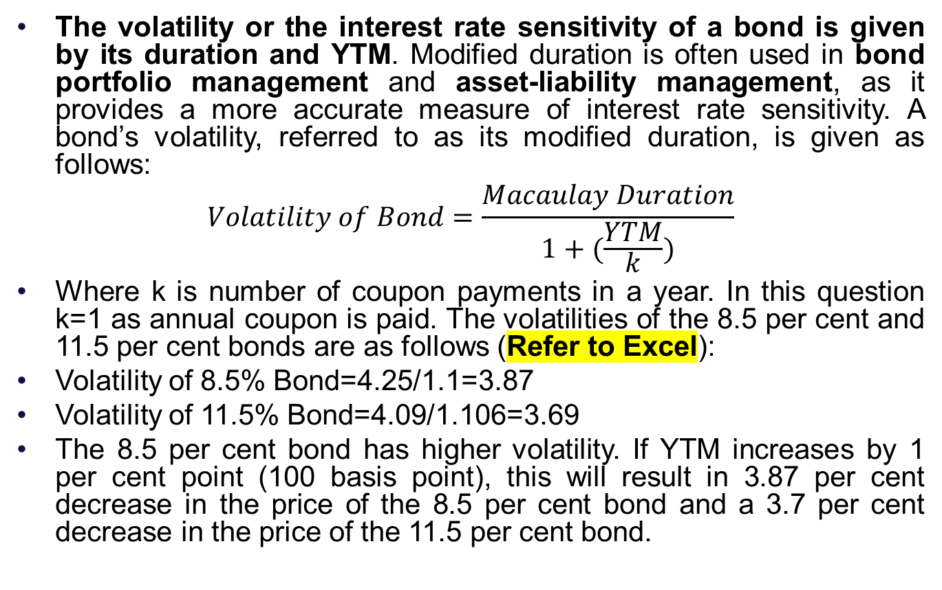
Modified duration (Volatility)
The volatility or the interest rate sensitivity of a bond is given by its duration and YTM. Modified duration is often used in bond portfolio management and asset-liability management, as it provides a more accurate measure of interest rate sensitivity. A bond’s volatility, referred to as its modified duration, is given as follows:
$$Volatility of Bond=\frac{Macaulay Duration}{1+(\frac{YTM}{k})}$$
Where k is number of coupon payments in a year. In this question k=1 as annual coupon is paid. The volatilities of the 8.5 per cent and 11.5 per cent bonds are as follows (Refer to Excel):
Volatility of 8.5% Bond=4.25/1.1=3.87
Volatility of 11.5% Bond=4.09/1.106=3.69
The 8.5 per cent bond has higher volatility. If YTM increases by 1 per cent point (100 basis point), this will result in 3.87 per cent decrease in the price of the 8.5 per cent bond and a 3.7 per cent decrease in the price of the 11.5 per cent bond.

Slide 35
Practice
The duration of a bond with $1,000 par value and a 7 percent coupon rate, three years remaining to maturity, and a 9 percent yield to maturity is calculated as: (Macaulay Duration=2.8 Years, Modified duration=2.62 years)
The duration of a zero-coupon bond with $1,000 par value, three years remaining to maturity, and a 9 percent yield to maturity is calculated as: (Macaulay Duration=3 Years, Modified duration=2.75 years)

Slide 36
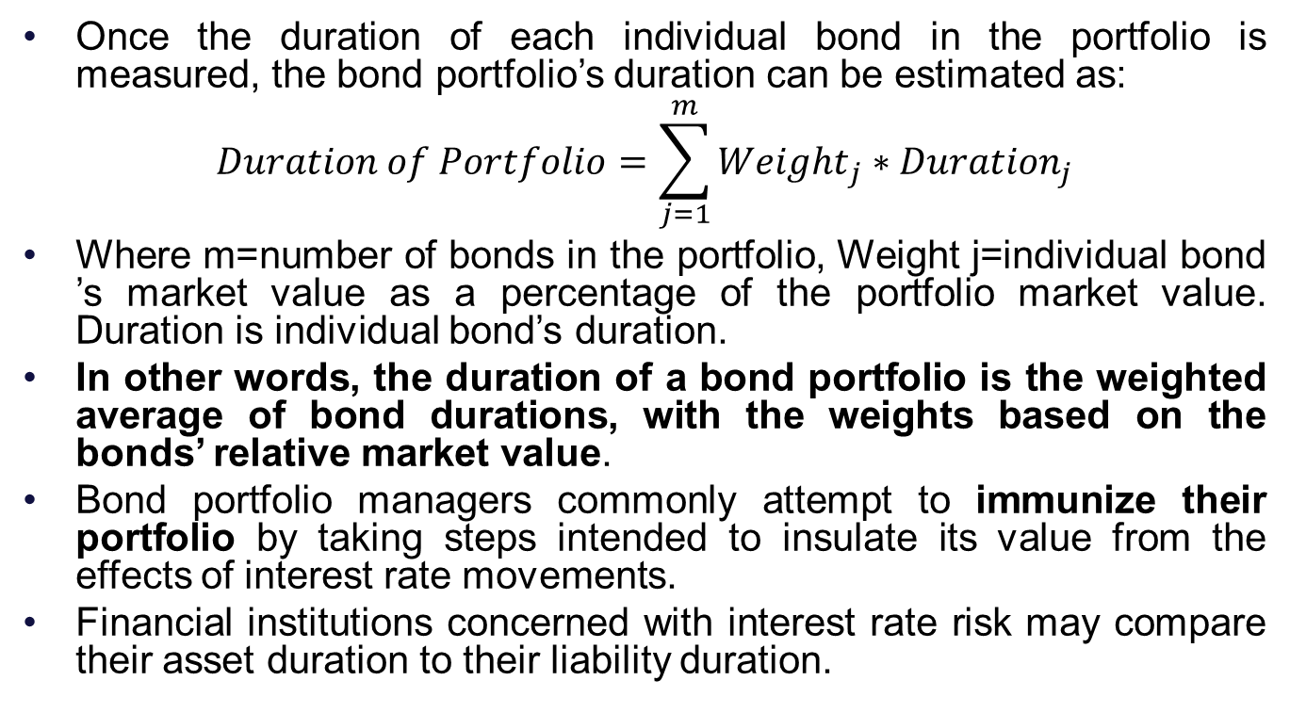
Duration of a Portfolio
Once the duration of each individual bond in the portfolio is measured, the bond portfolio’s duration can be estimated as:
$$Duration of Portfolio=\sum_{j=1}^{m}{{Weight}_{j}∗{Duration}_{j}}$$
Where m=number of bonds in the portfolio, Weight j=individual bond ’s market value as a percentage of the portfolio market value. Duration is individual bond’s duration.
In other words, the duration of a bond portfolio is the weighted average of bond durations, with the weights based on the bonds’ relative market value.
Bond portfolio managers commonly attempt to immunize their portfolio by taking steps intended to insulate its value from the effects of interest rate movements.
Financial institutions concerned with interest rate risk may compare their asset duration to their liability duration.

Slide 37
Bond Convexity
A more complete formula to estimate the percentage change in price in response to a change in yield will incorporate the property of convexity as well as modified duration.
The estimated modified duration suggests a linear relationship in the response of the bond price to a change in bond yields.(However, the actual relationship is convex)
For relatively large changes (more than 1%) in the bond yield, however, the bond price adjustment as estimated by modified duration is less accurate.
It is a more precise measure of interest rate sensitivity than duration, especially for bonds with non-linear price-yield relationships.
Duration measures the first derivative of the bond's price with respect to yield. Convexity measures the second derivative.

Slide 38
Bond Convexity
Since more maturity induces more sensitivity, the convexity is also more pronounced for bonds with a long maturity.
The prices of low- or zero-coupon bonds are more sensitive to changes in yields. Similarly, bond convexity is more pronounced for bonds with low (or no) coupon rates.
Convexity implies that bond price increases more rapidly when interest rates fall than they decrease when interest rates rise. It indicates that the potential gains from falling interest rates are typically larger than the potential losses from rising interest rates.
This is beneficial for bond investors, as it provides a cushion against rising interest rates.
Convexity is termed as a friend for bond investors.

Slide 39
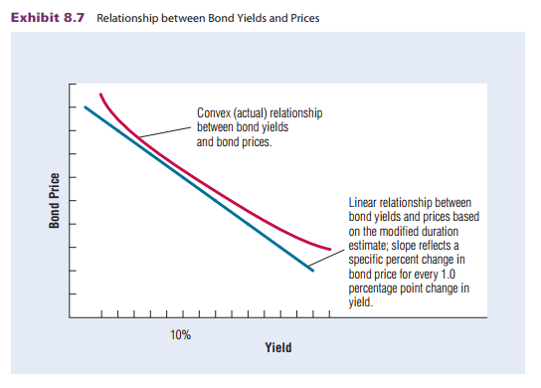
Bond Convexity

Slide 40
Bond Investment Strategies
Matching Strategy: Some investors create a bond portfolio that will generate periodic income to match their expected periodic expenses. For example, an individual investor may invest in a bond portfolio that will provide sufficient income to cover periodic expenses after retirement. Alternatively, a pension fund may invest in a bond portfolio that will provide employees with a fixed periodic income after retirement.
Laddered Strategy: With a laddered strategy, funds are evenly allocated to bonds in each of several different maturity classes (5-, 10-, 15-, and 20-year maturities with equal weights). The purpose is diversity of maturities as different sensitivities to interest rate risk. It reduces the impact of interest rate risk.

Slide 41
Bond Investment Strategies
Barbell Strategy: With the barbell strategy, funds are allocated to bonds with a short term to maturity as well as to bonds with a long term to maturity. Short-term for liquidity and long-term for high-yield. Thus, this strategy allocates some funds to achieving a relatively high return and other funds to covering liquidity needs.
Interest Rate Strategy: With the interest rate strategy, funds are allocated in a manner that capitalizes on interest rate forecasts. This strategy requires frequent adjustments in the bond portfolio to reflect the prevailing interest rate forecast. Example: an expectation of higher interest rates, the bond portfolio will be revised to concentrate on bonds with short terms to maturity. Because these bonds are the least sensitive to interest rate movements, they will limit the potential adverse effects on the bond portfolio’s value. And vice versa.

Slide 42
Valuation and Risk of International Bonds
Although the yields on newly issued government bonds vary among countries, they tend to move in the same direction.
The value of government bonds changes over time in response to changes in the risk-free interest rate of the currency denominating the bond and in response to changes in the perceived credit risk of the bond.
Factors affecting international bond prices:
Influence of Foreign Interest Rate Movements
Influence of Credit Risk
Influence of Exchange Rate Fluctuations

Slide 43
International Bond Diversification: Benefits
Reduction of Interest Rate Risk: International diversification of bonds reduces the sensitivity of the overall bond portfolio to any single country’s interest rate movements.
Reduction of Credit Risk: Investment in bonds issued by corporations from a single country (economic situations) can expose investors to a relatively high degree of credit risk.
Reduction of Exchange Rate Risk: Financial institutions may attempt to reduce their exchange rate risk by diversifying among foreign securities denominated in various foreign currencies.
International Integration of Credit Risk: An increase in credit risk in one country may be transmitted to another country, a process that is sometimes referred to as credit contagion.

